Slide 1
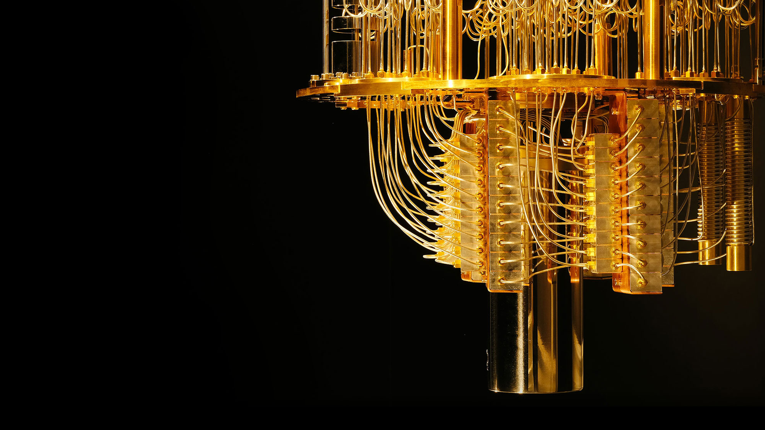
2 Qubit Systems and Entanglement
Priya Angara, Ulrike Stege

Slide 2

Two Qubit System

Slide 3


First Qubit

Slide 4


Second Qubit

Slide 5
Two qubit systems
When we have two quantum states in the same systems, the qubit can be in one to all of the following states
|00>
|01>
|10>
|11>

Slide 6
Psi for a two qubit system

Slide 7
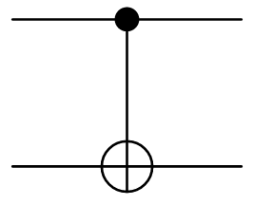


Controlled-NOT: A Two Qubit Gate
Controlled NOT gates make use of two qubits
The first qubit decides the fate of the second qubit
If the first qubit is |0>, the second qubit remains unchanged
If the first qubit is |1>, the second qubit flips state

Slide 8

Let’s Qode!

Slide 9
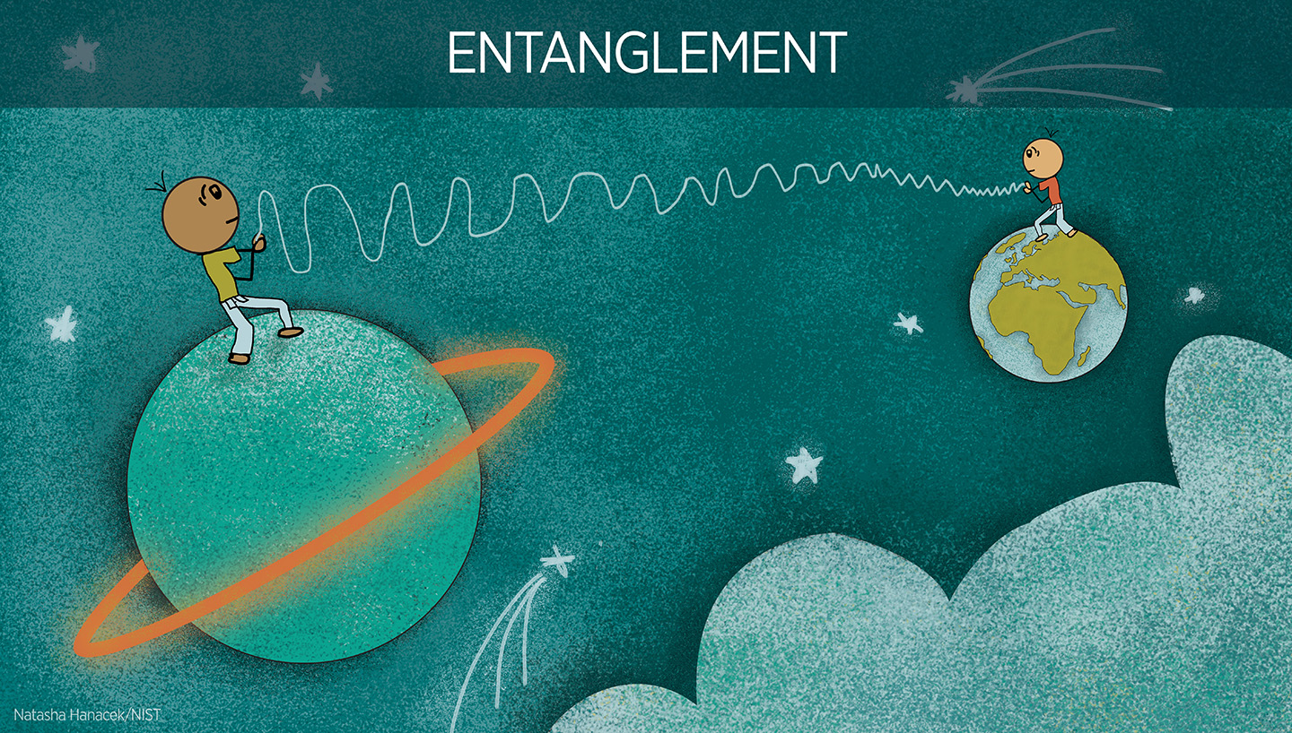

Slide 10

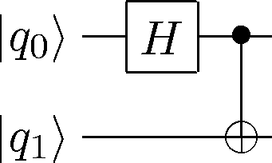

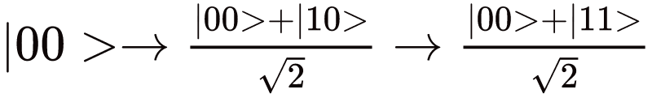
CNOT + Hadamard: Something Spooky
H C-NOT

Slide 11
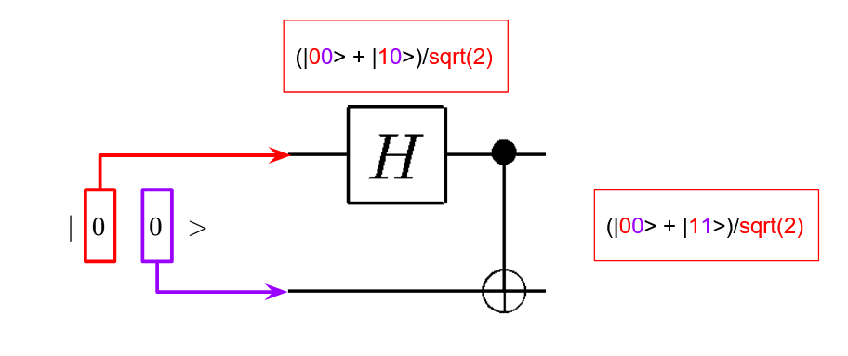
Which Qubit goes first?

Slide 12

Measurements
We can measure both qubits at the end of our experiments like the single qubit systems.
However, we can also do a partial measurement – This means we measure only one of the qubits.
Maybe we can look at the measured qubit, and speculate about the unmeasured one?
We’ll do this on our worksheet

Slide 13

Entanglement: Spooky Action at a distance
If we measure the first qubit, we know that it could be either 0 or 1.
But once we measure the first qubit, can we say something about the second qubit?

Slide 14
First Qubit: 0
Second Qubit: ?

Slide 15
First Qubit: 1
Second Qubit: ?

Slide 16
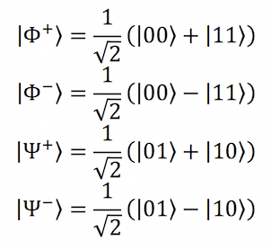
First Qubit: 0
Second Qubit: ?

Slide 17
First Qubit: 1
Second Qubit: ?

Slide 18
Let’s try this with some other states
Hadamard + CNOT on:
|01>
|10>
|11>
Let’s practice!

Slide 19

Bell States

Slide 20
Let’s Qode!

